Slide 1
Blockchain Smart Contracts for Policy Compliance: A Healthcare Perspective
Hemanth Chowdary, Md Al Amin, Seshamalini Mohan and Indrajit Ray
Computer Science Department, Colorado State University, Fort Collins, CO, USA

Slide 2
OCR HHS - Compliance Complain
Year | Complains | Compliance Reviews | Technical Assistance | Total Cases
2018 | 25089 | 438 | 7243 | 32770
2019 | 29853 | 338 | 9060 | 39251
2020 | 26530 | 566 | 5193 | 32289
2021 | 26420 | 573 | 4244 | 31237
Office for Civil Rights (OCR) at the U.S. Department of Health and Human Services (HHS)
2
Notes:
OCR HHS – Compliance Complain
Impermissible uses and disclosures of PHI
Lack of safeguards of PHI
Lack of patient access to their PHI
Lack of administrative safeguards of electronic PHI
Use or disclosure of more than the minimum necessary PHI

Slide 3
Government
Federal
Regulatory Agency
HIPAA
Organizational Policy
Obligatory Policy
Patient Provider Contract
Treatment Consent
State
Local
HITECH
GDPR
Personal Information
Insurance Information
Emergency Contact
Roles and Responsibilities
International
Financial Liabilities
Role Hierarchy
Healthcare
Policy Compliance Requirements
2
Notes:
Problem Statement
For stronger security guarantees, demonstrating / proving policy compliance is must
Policy compliance is challenging since policies can range from national level policies to state-level, city-level, organization-level policies, and also individual user level
Problems in policy specification and implementation remain unidentified until a breach
Organizational subcultures often lead to policy violations

Slide 4

Policy Enforcement, Provenance, & Compliance
Policy
Provenance
Activity
Lineage
Ensure
Policy
Compliance
Policy
Enforcement
Certify
3
Notes:
Policy Enforcement
Enforced while evaluating authorization decision
Executed available and applicable policies
Must be related with subject, object, action, and other conditions
Detection of violations and taking action when a violation occurs
Well-defined and implemented policies ensure proper authorization
Improper policies lead flawed authorization decision
Policy Compliance
Indicates how organizations are following ordinance or guidelines
Ensures better protection mechanisms are active
Indicates further improvement
Policy Provenance
Provides lineage of all activities of a policy
Gives all operations history for subjects
Shows performed actions on objects or resources
Maintains integrity to ensure immutable lineage records
Ensures proper policy enforcement and compliance
Compliance Issues
Audit trails are not analyzed timely and properly
Policy provenance not maintained strictly
Audit trails are tampered to cover unwanted activities
Users oriented compliance reports not given
Proposed Approach
Immutable, integrity verified storage of audit trail
Blockchain’s decentralized consensus mechanism
Implementing policies as smart contracts ensures compliance via auto triggering and consensus mechanism
Proof of Compliance (PoC) blockchain consensus mechanism to verify compliance and non-compliance actions

Slide 5
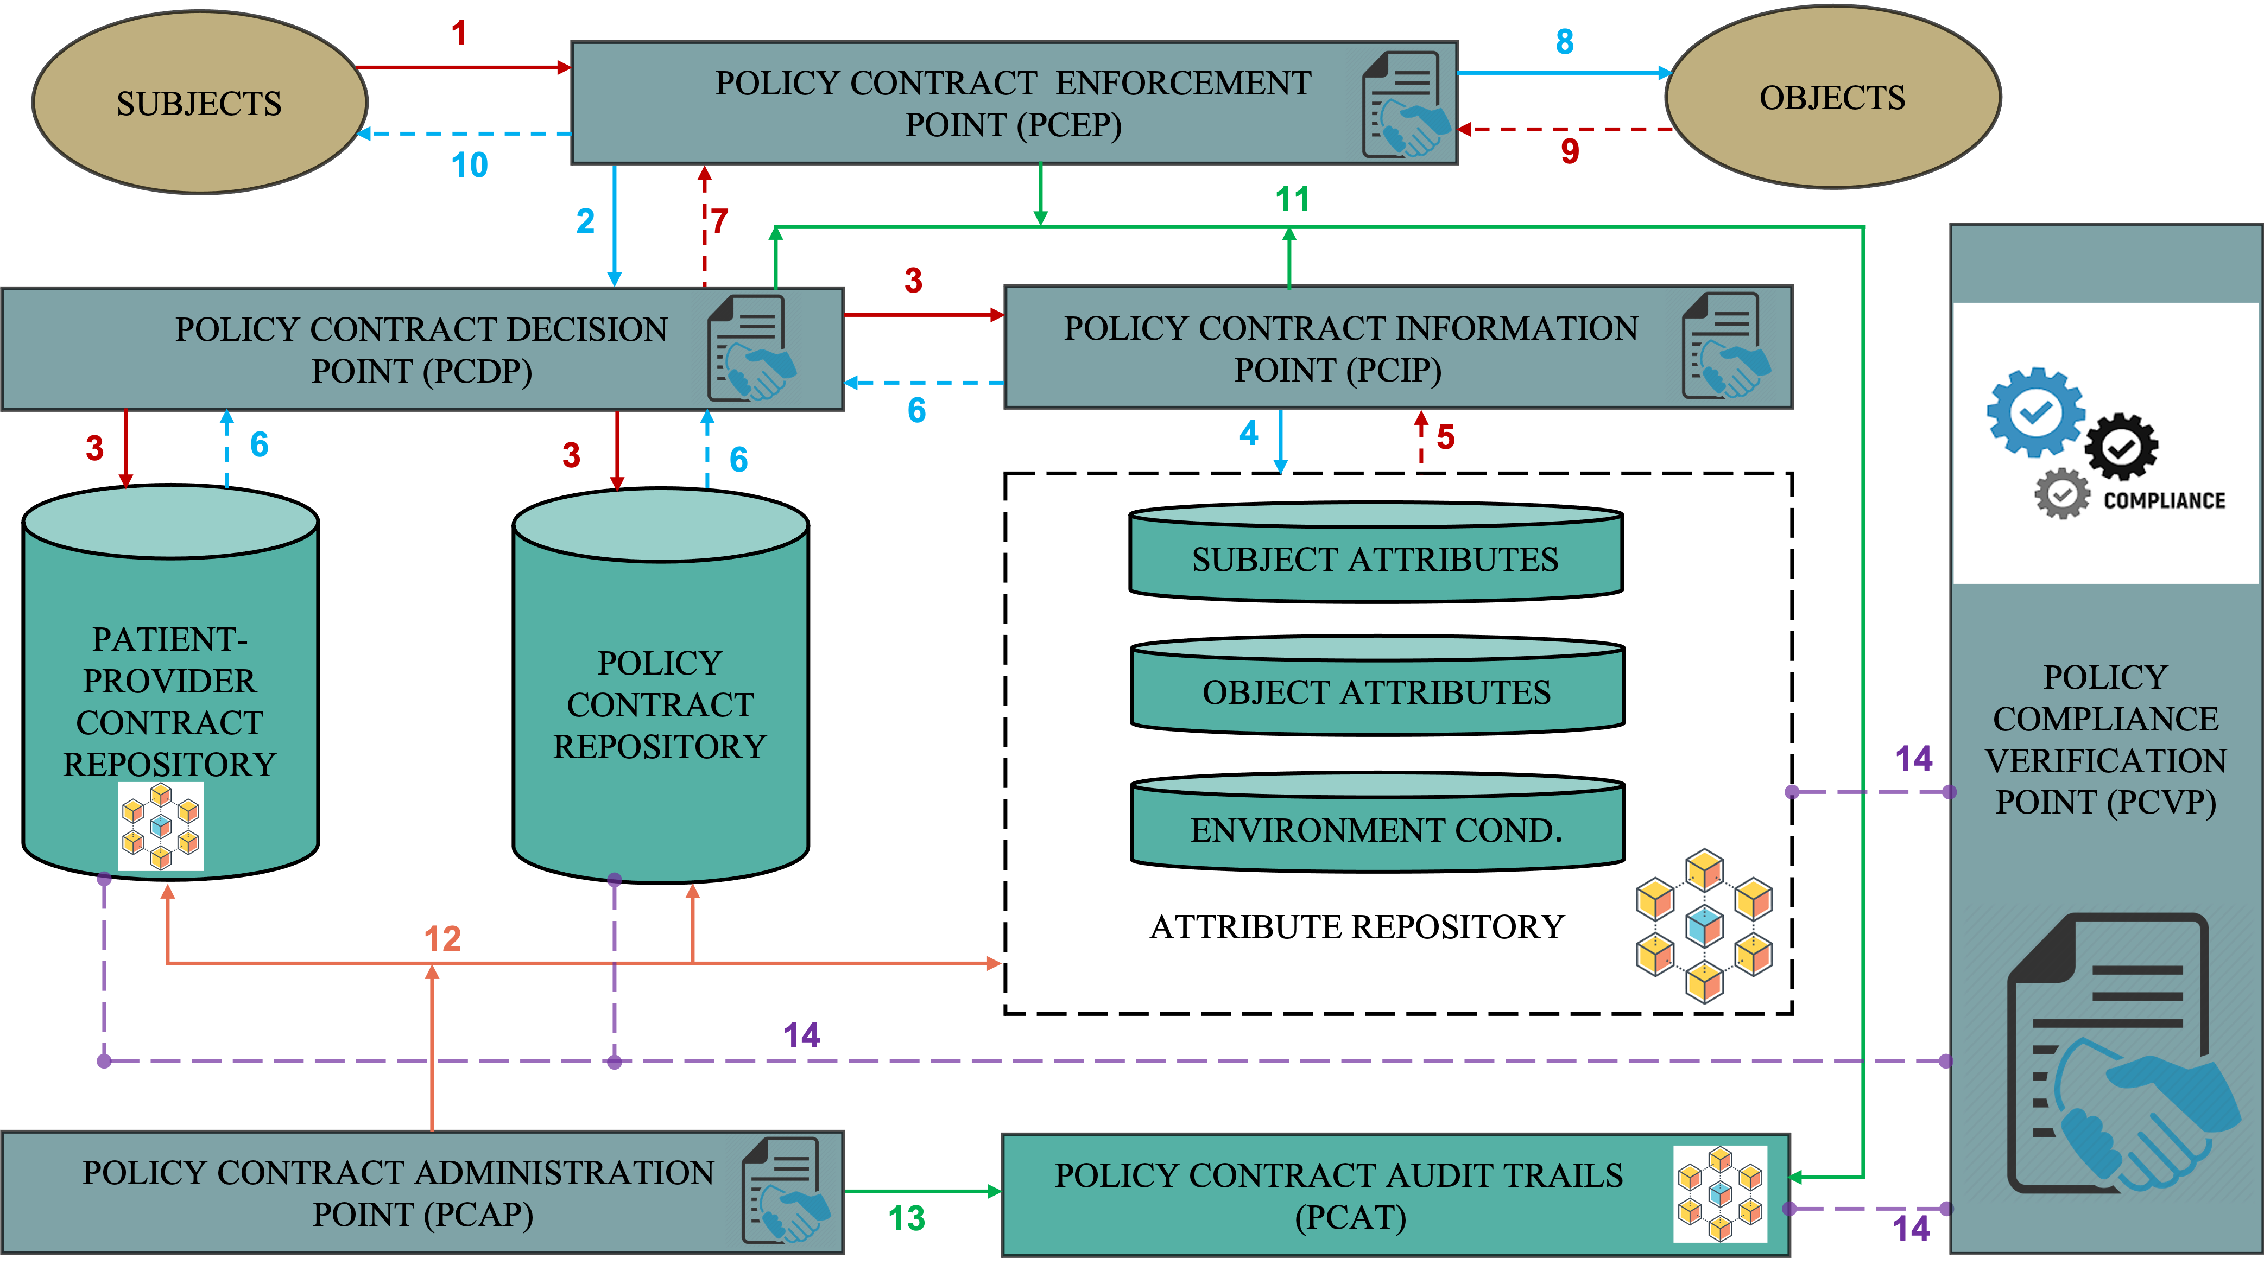
Contract Based Policy Enforcement
4

Slide 6
Visit booth # for our poster & Have some questions

